Slide 1



Selective Laser Etching of Slumped Mirrors for X-Ray Astronomy
Dillan Synan
Mentor: Dr. Brandon Chalifoux, Lightweight Optics Lab, Wyant College of Optical Sciences
Arizona NASA Space Grant Symposium, 19 April 2025
Notes:
name, year
Project name

Slide 2


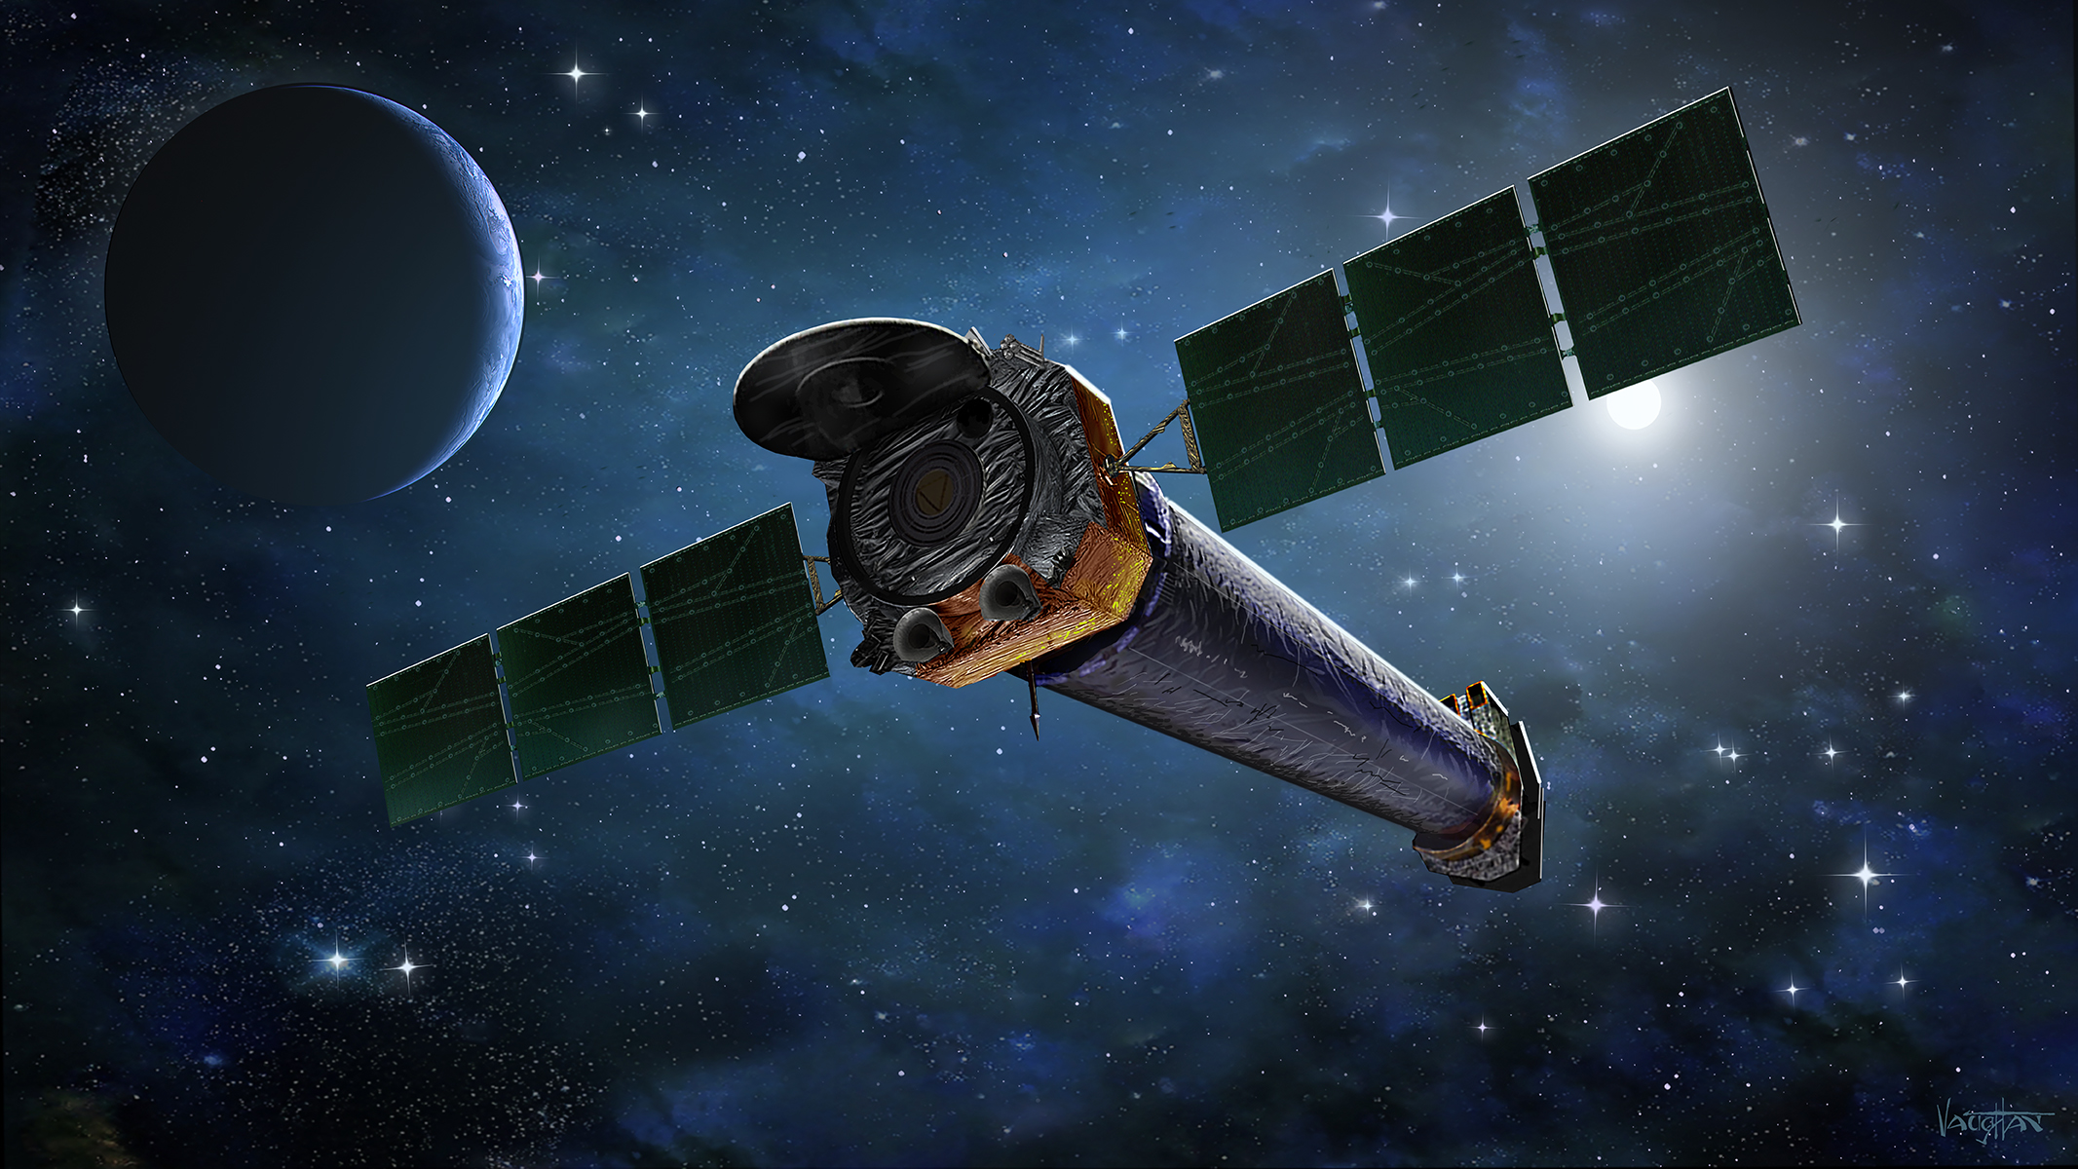
Purpose:
The current NASA flagship X-ray space telescope, Chandra, is 26 years old
My research group has been tasked with developing technology for next generation X-ray optics
Nasa.gov
Notes:
In case you don’t know, there is a space telescope that images x ray data
The wider purpose of my project is:

Slide 3
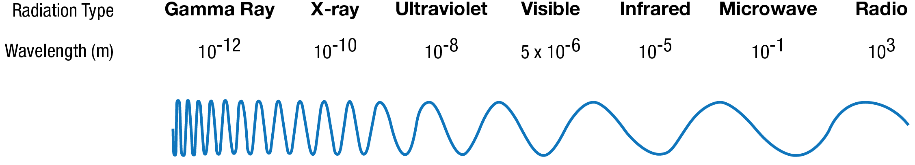
Background:
X-Ray optics are challenging
Since the wavelength of X-rays are so small, lenses cannot be used and imperfections on the order of an X-ray prevent reflection
All X-ray telescopes are mirror-based, precise, and in space
One approach is to use a collection of small mirrors where incident x-rays just barely graze the mirror surface
Nasa.gov
Notes:
So a little bit about x –rays:
X-rays are really small, which creates a lot of unique challenges
…
So how do you make the optics for an X-ray space telescope?

Slide 4
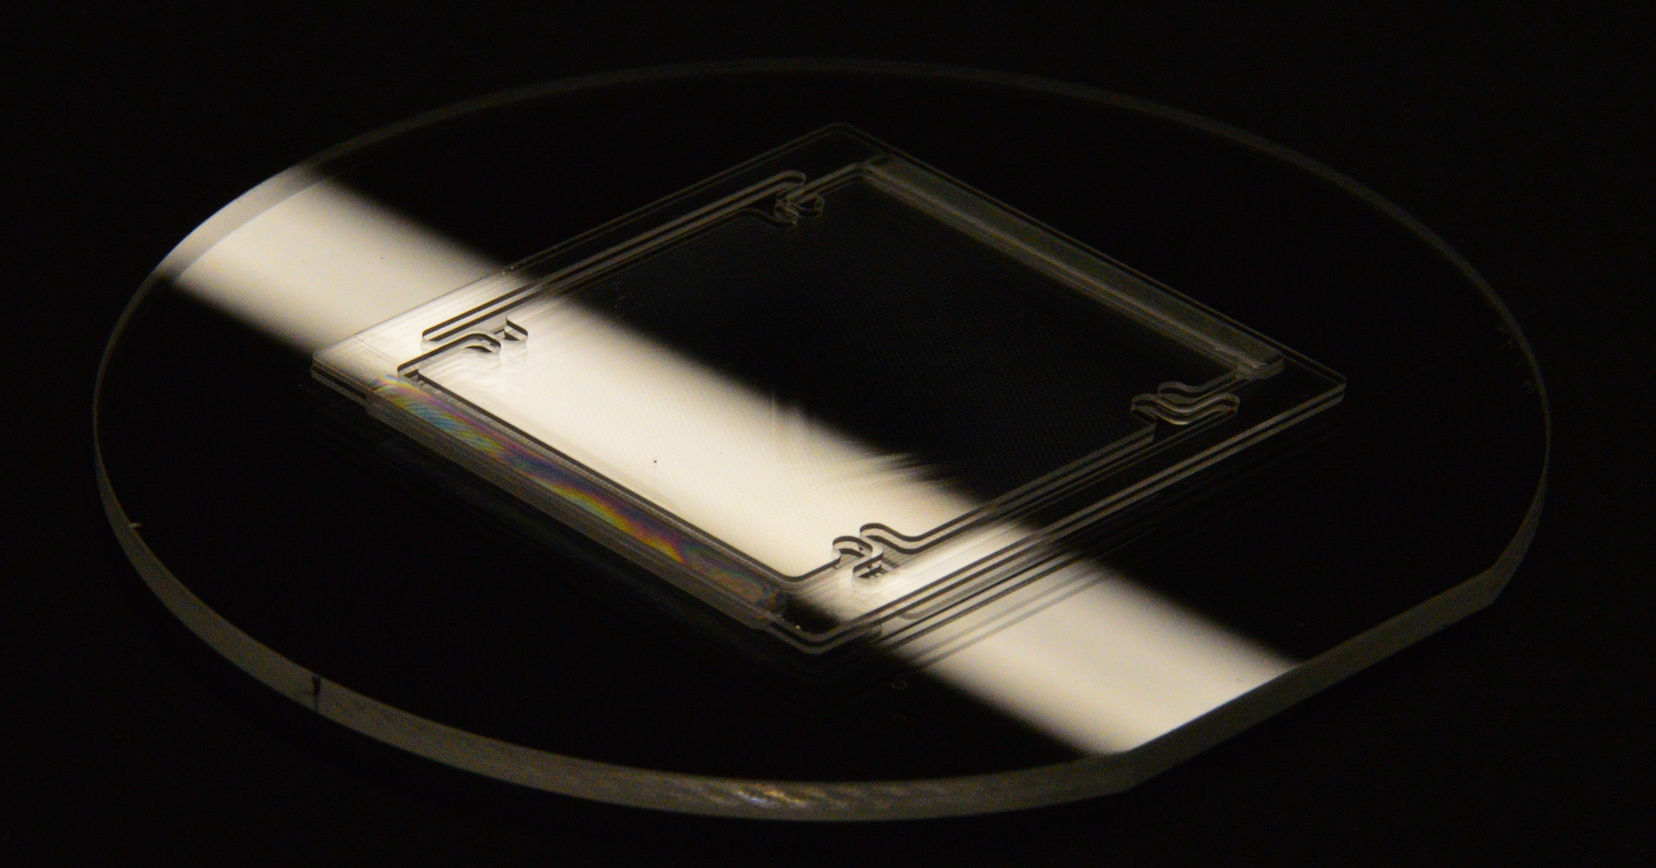
Objective: Find a way to write and etch Flex (Mirror) Segment pattern into curved substrate
25 mm
Flat Flex Segment after laser writing process, before chemical etching
Chalifoux, APRA 2025
Notes:
So, what really is my project?
Explain that writing onto curved substrates wasn’t a capability of the laser system

Slide 5
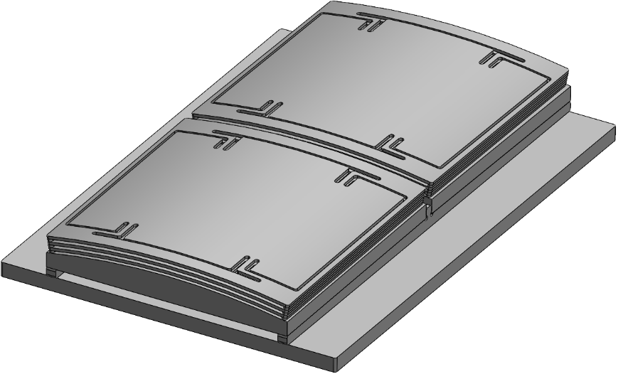
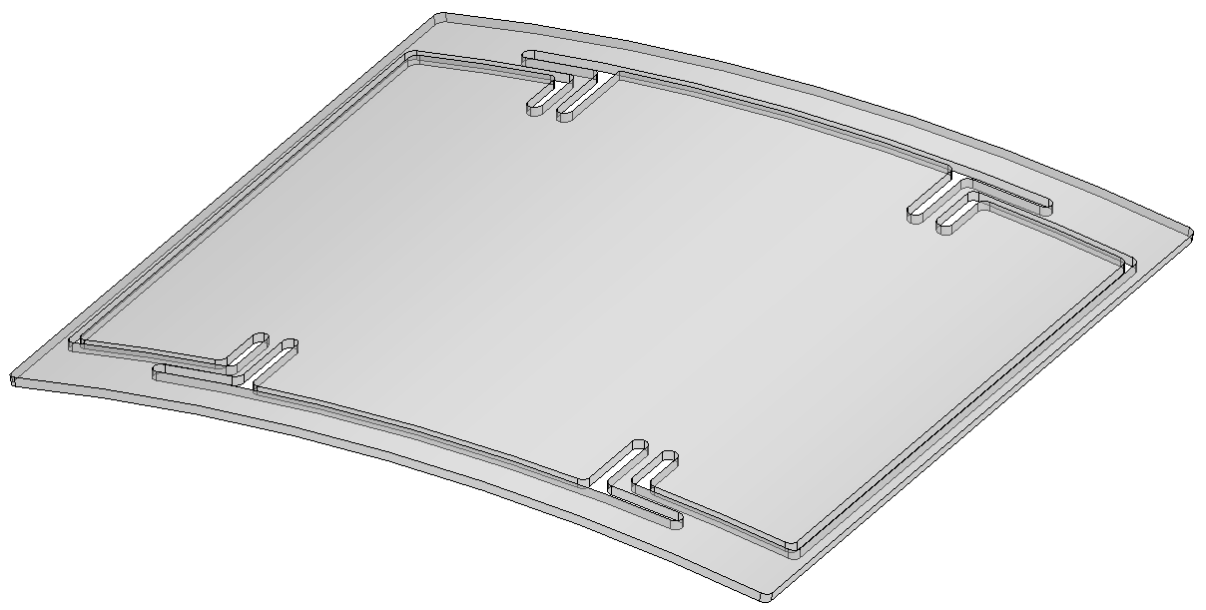
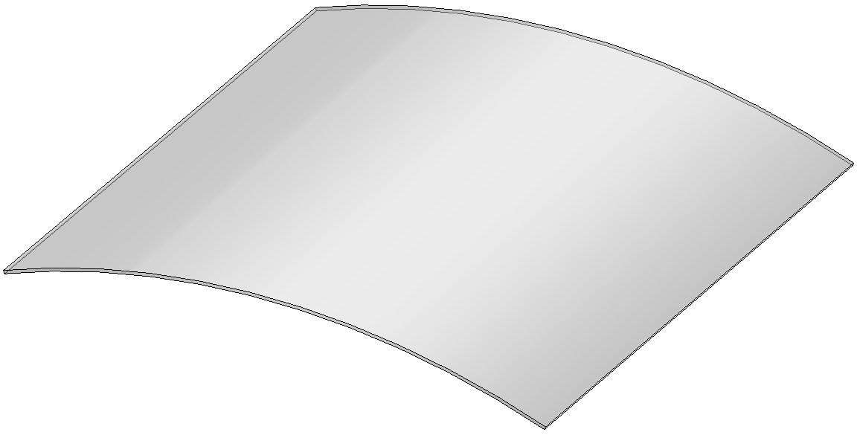






Background:
Flex Segment fabrication
Coatings
Backside coating
Frontside coating
Iterate to convergence
Flex Module
Flex Segment
Slumping
Writing,
etching
Spacer fabrication
Welding
Alignment & figuring
X-ray testing
Base fabrication
Repeat for all shells
Oversized segment
Assembly
Chalifoux, APRA 2025
Notes:
Now, a brief overview of the whole process of making these mirrors:
…

Slide 6
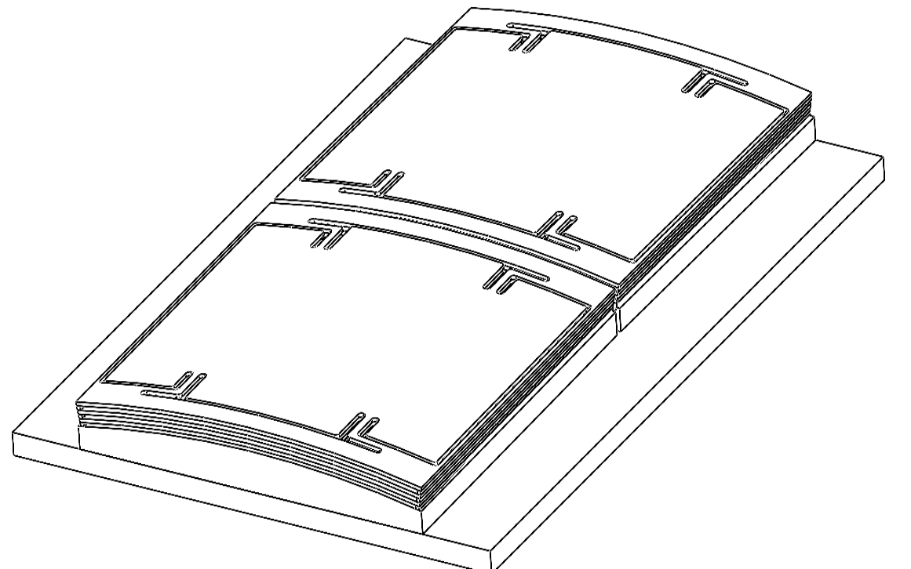
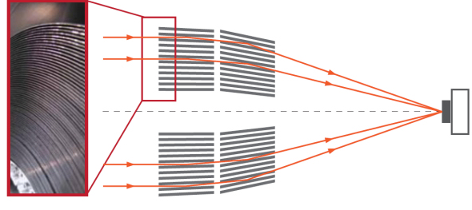
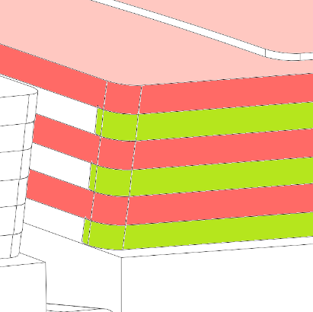
Background:
Anatomy of a Flex Module
Flex Segment
50 mm × 50 mm × 0.5 mm
X-rays out
Cross section of X-ray mirror system
Optical surface
Concave side
Secondary mirrors
Realignment beam
Sci.esa.int
Isolation flexure
Primary mirrors
X-rays in
Flex Segments welded to spacers
6
6
6
Notes:
Now, we take a closer look at one unit of the mirror system (a flex module)
…

Slide 7
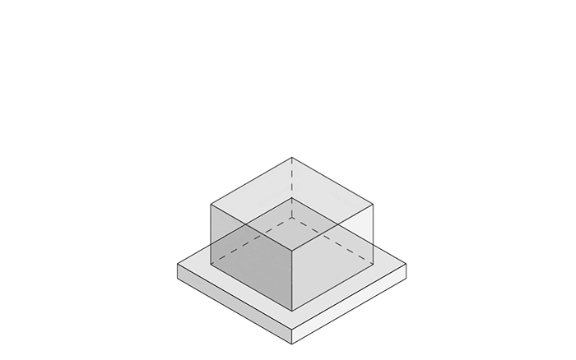
Background:
Selective Laser Etching:
Femtika.com
Notes:
So, how exactly, do you write a fabricate a part using a laser?
…

Slide 8
Objective: Find a way to write and etch Flex Segment pattern into curved substrate
Accomplishments:
Learned how to operate the laser system
Developed workflow to write machine code from desired geometry
Wrote 3D curved patterns into a flat substrate
Wrote 3D curved patterns into a curved substrate
Etched physical product
Notes:
Now that we know a lot more about the purpose of the project, what was the goal, and what did I actually do?
…

Slide 9
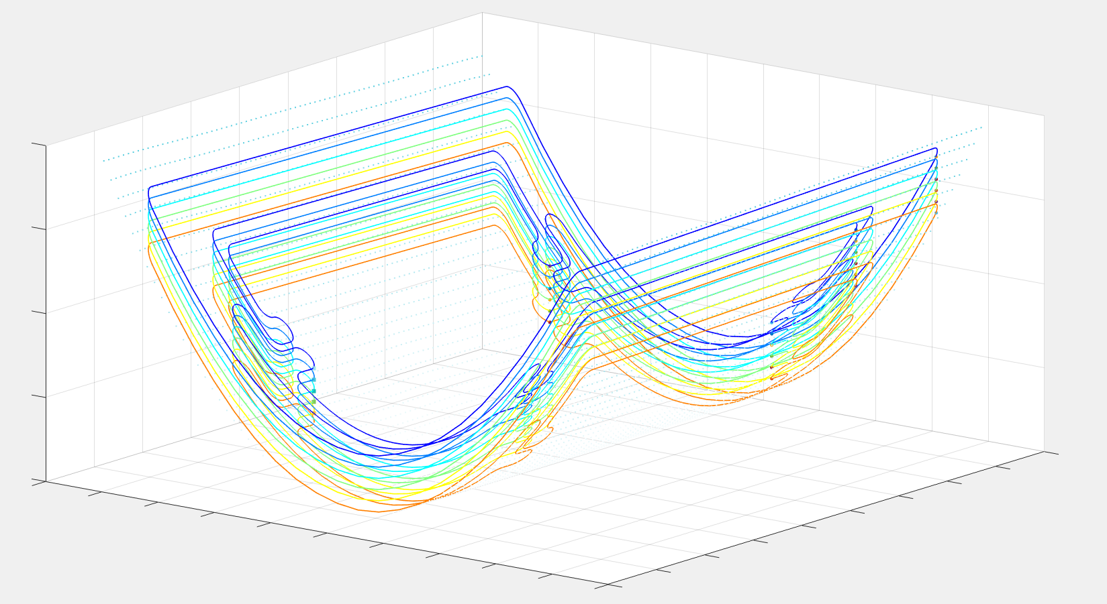
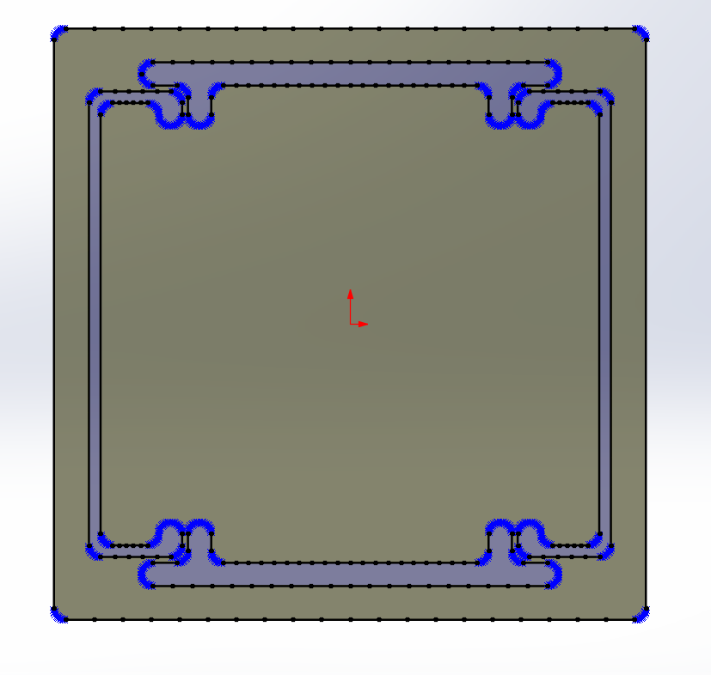
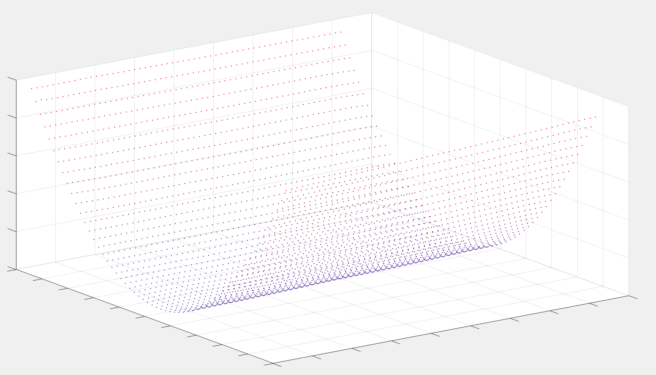
Workflow:
Design part, export as 2D DXF file. SOLIDWORKS
Interpret 2D DXF output, adds laser commands. CADFusion
Produce 2D laser program (text file). Custom Lab Software
Interpolate 2D laser program onto surface data. My Custom Software
Write new 3D pattern using modified text file. Laser System
Scan part surface. Chromatic Confocal Sensor
Output surface data. Custom Lab Software
Notes:
So to visualize the process I landed on:

Slide 10
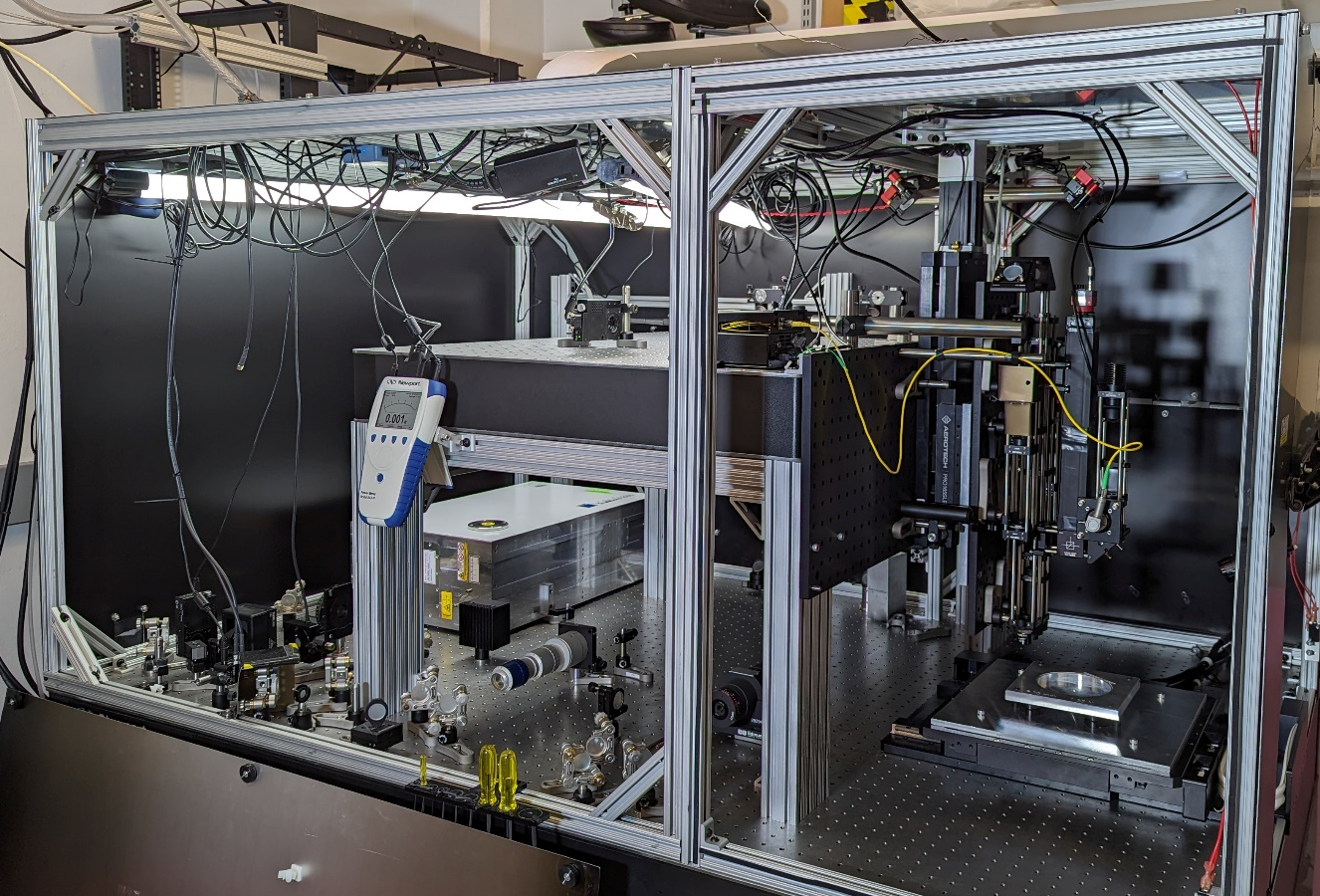
Equipment:
Ultrafast Laser
Workpiece
Laser parameters:
1.2 μJ pulse energy
52 kHz repetition rate
3 ps pulse duration
500 nm pulse pitch
Write speed: 25 mm/s
Layer spacing: 5 μm
Circular polarization
Substrate glass:
Schott Borofloat 33
Linear Translation Stage, Moves in z
Chromatic confocal sensor not shown
x
y
Translation Stage, Moves in xy Plane
Chalifoux, APRA 2025
z
Beam conditioning
Beam focusing, imaging, on-machine metrology, and workpiece stage/ chuck
Notes:
So once you’re in the lab and ready to make your part, how does this work?
The laser is on one side, and its light has to be directed and manipulated in many ways before it is used.
Special type of laser, an ultrafast laser.
Explain motion
Explain how to do process:
Clean and mount slumped substrate onto a workpiece
Perform surface scan using a tool called the chromatic confocal scanner
Run my code using scan data and part data
Confirm that the file and graph I wrote makes sense
Enclose laser system and run

Slide 11
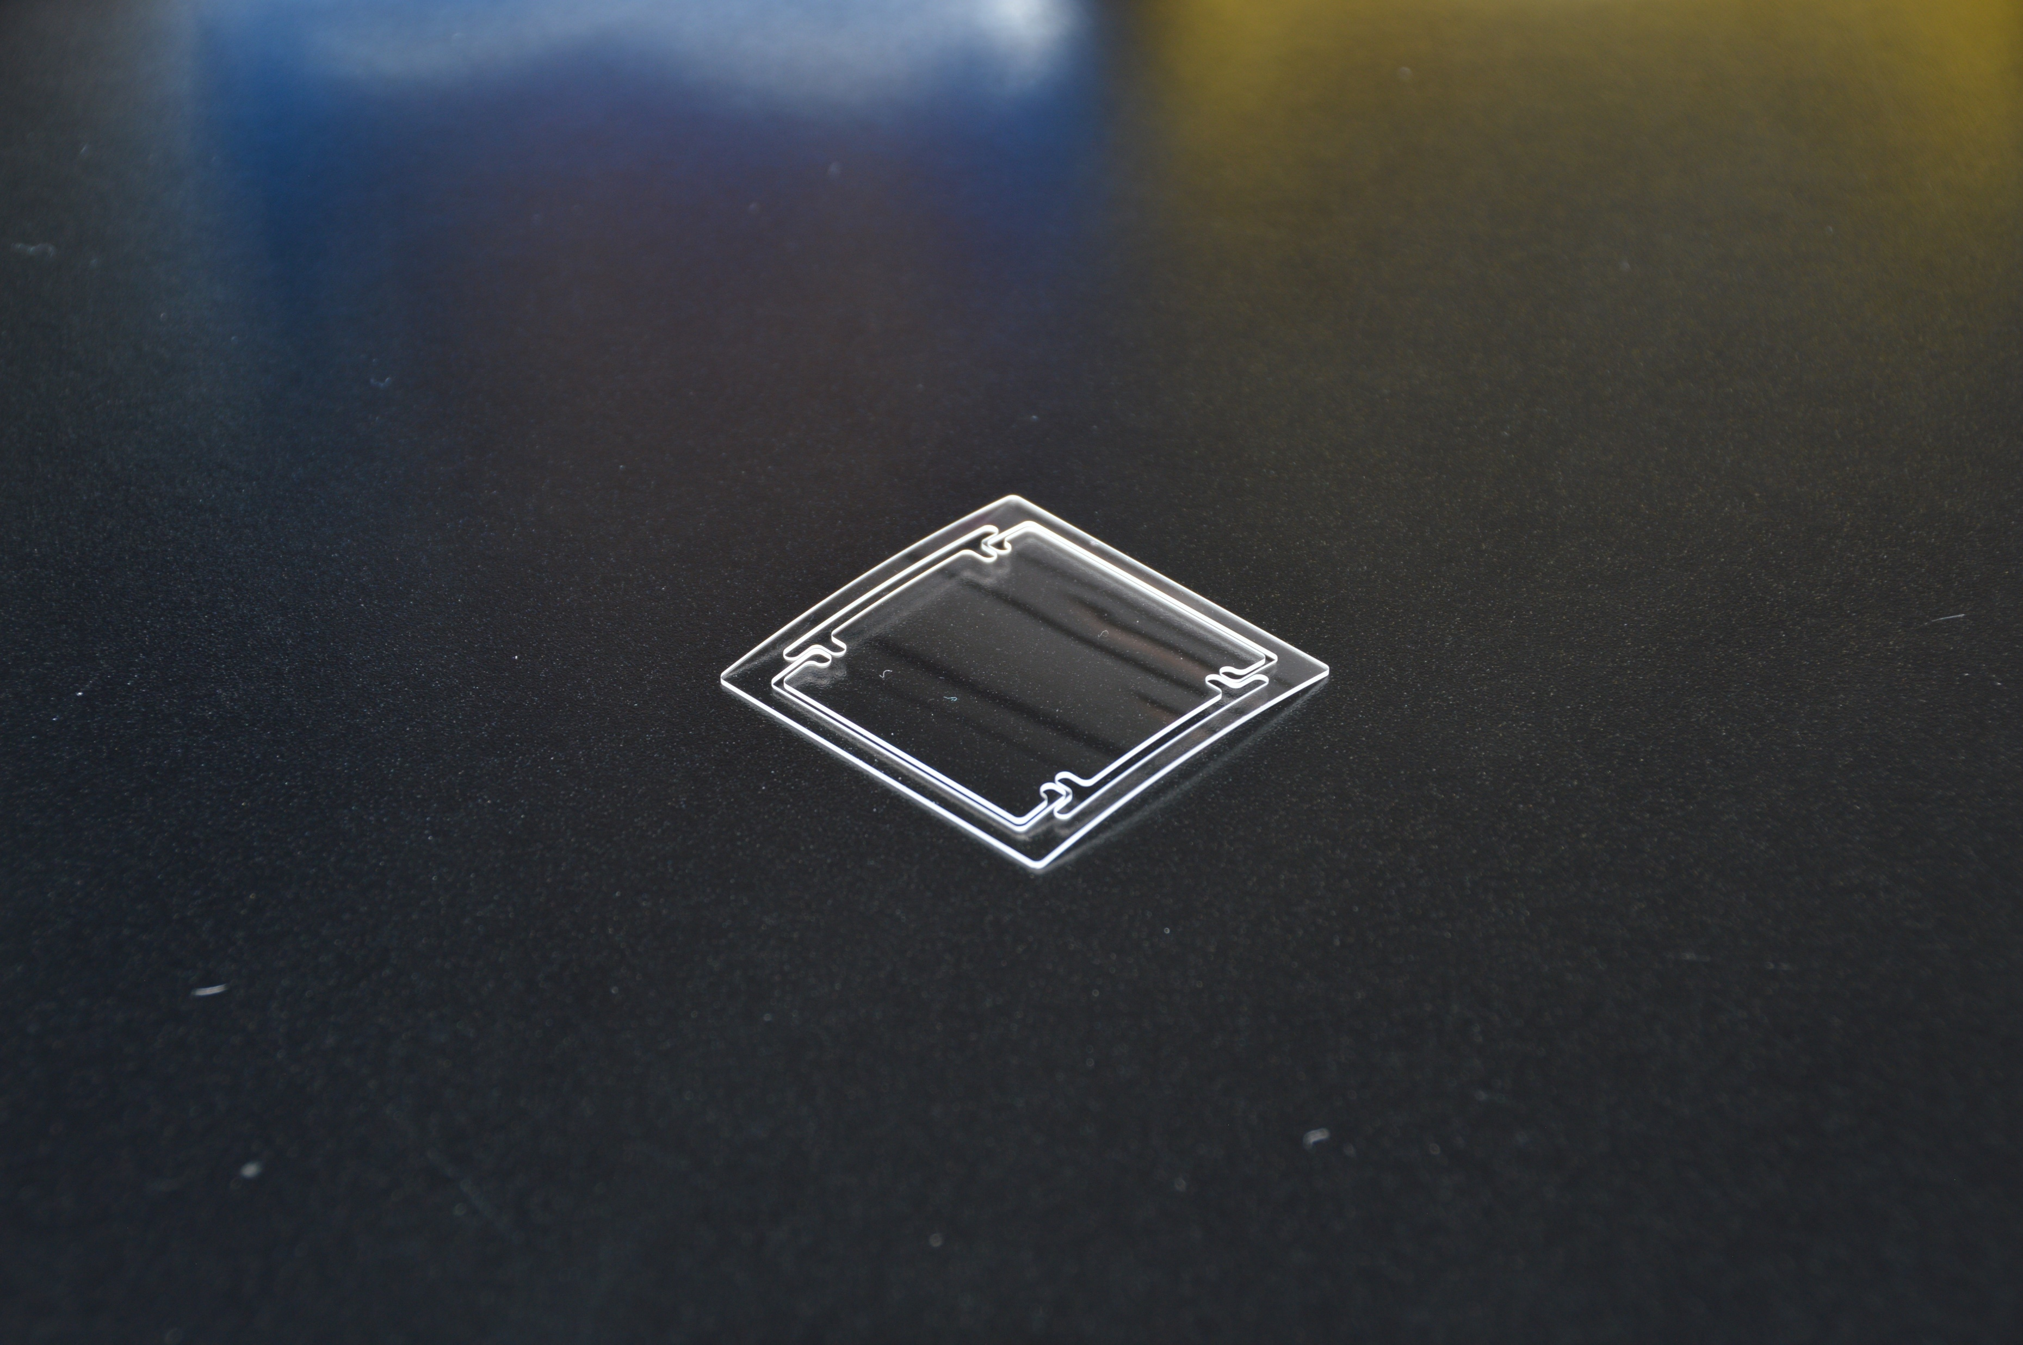

Results:
Notes:
AND, I was successful!

Slide 12
Acknowledgments:
My PI and Space Grant mentor, Dr. Chalifoux
Research Engineer Ian Arnold
Arizona Space Grant

Slide 13
Thank You!

Slide 14
Citations
https://femtika.com/process/selective-laser-etching/ for SLE GIF
RTF kickoff 2024, Brandon Chalifoux
NASA APRA Proposal
Em spectrum: https://mynasadata.larc.nasa.gov/basic-page/electromagnetic-spectrum-diagram

Slide 15
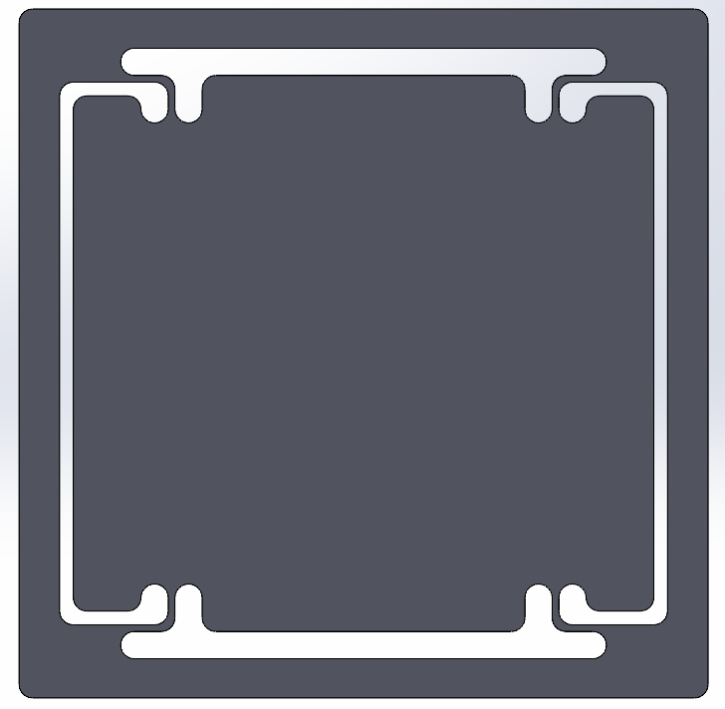
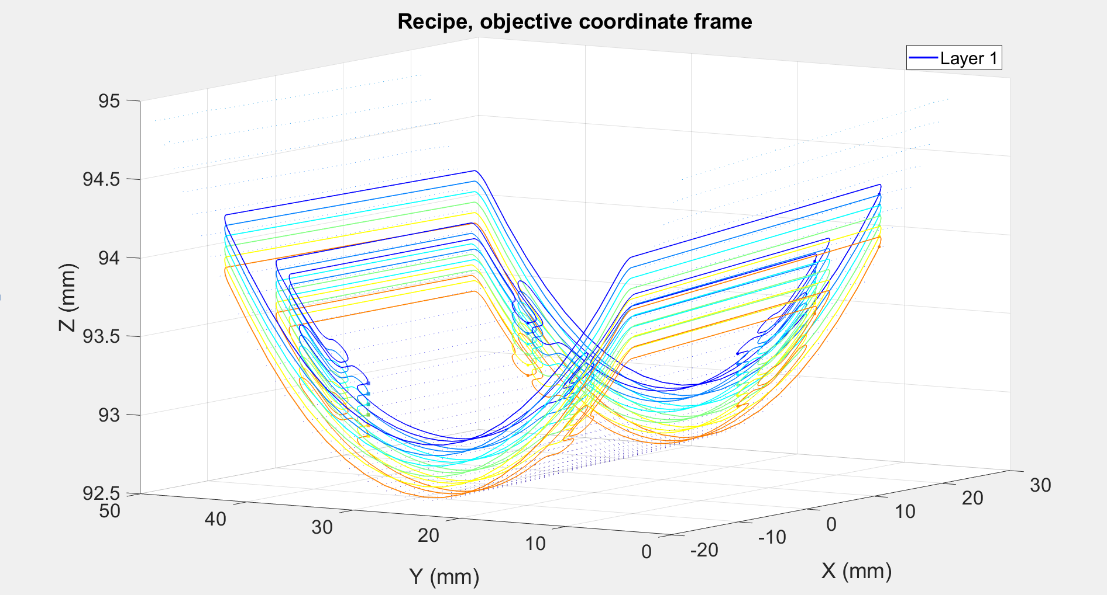
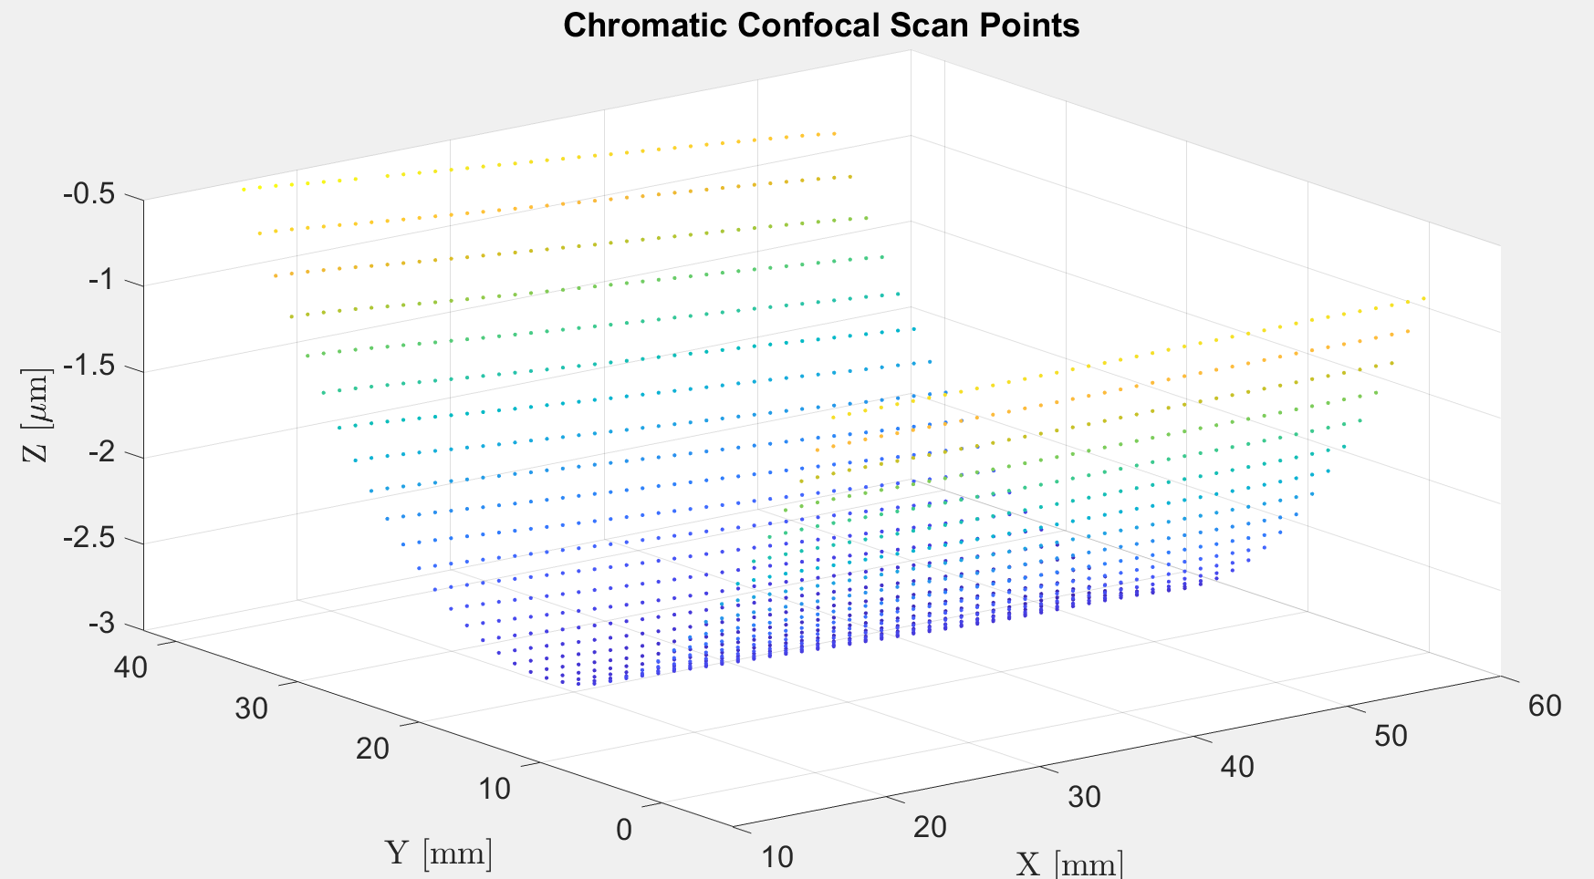
Interpolating Flex Segment onto Substrate:
Notes:
Skipping over many details, the process can be visualized as such:
Design flex segment, turn lines into many points because each point must eventually have an associated z coordinate
While in the lab, use position scan data from substrate surface to write machine code for slumped flex segment
Also graph it to make sure you’re writing what you should be writing
As for the system that I use to modify these slumped mirrors:

Slide 16

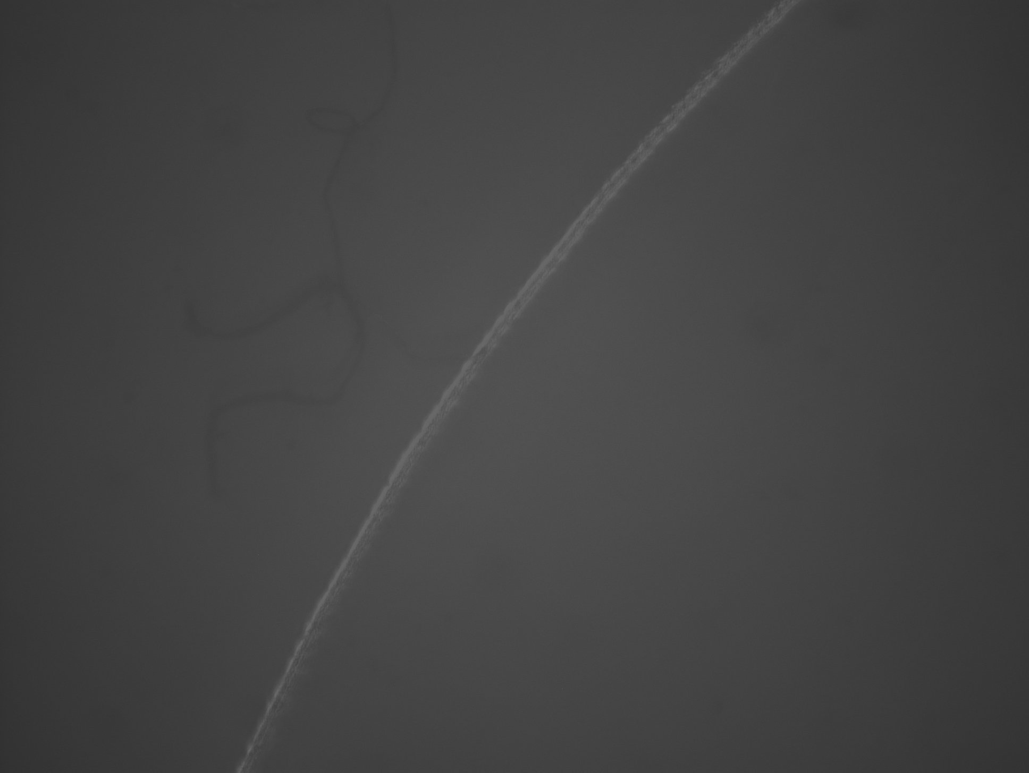
Approximation of curves as small line segments:
1mm radius curve split into 5 line segments, 8.6 micron sag, compensated by VELOCITY ON
20x zoom
40x zoom

